Slide 1
Collaboration that gives you wings

Slide 2
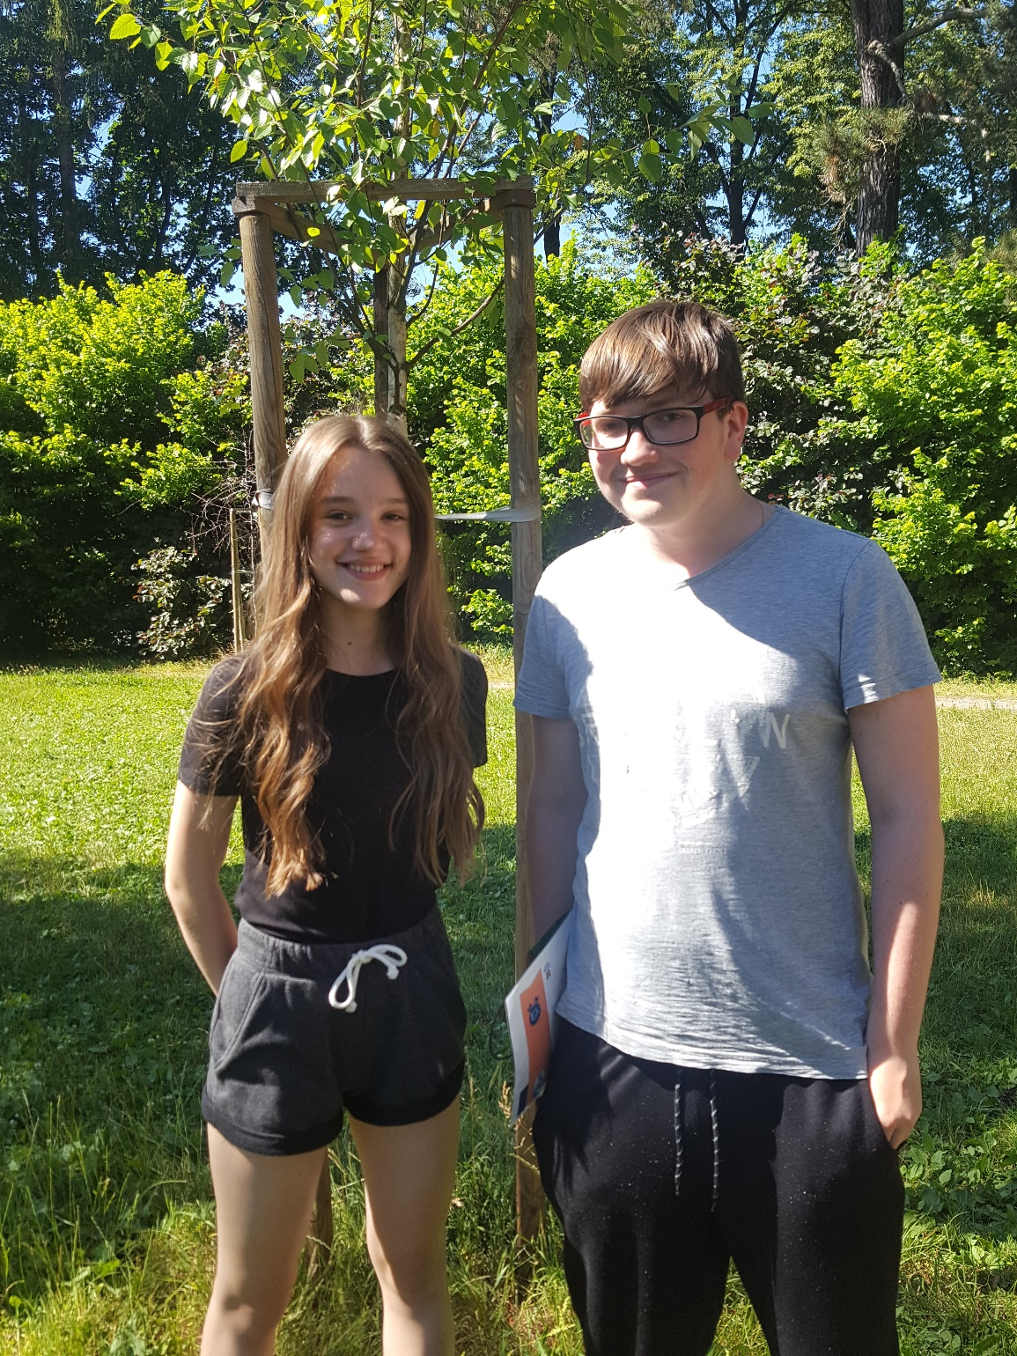

Slide 4
As…
Want…
So that….

Slide 5
“As Ondra and Anet, we want our classmates to design the storyline of a game with characters, a matching name, a logo and promotion poster so that they are able to use their learnt English in a creative way that matches with their interests.”

Slide 6
Stories
Criteria
Minimum 300 words
Structured with begin, middle and end
Explain the goal of the game
Storyline
At least 3 characters
Description
Drawring
Each on an A4 paper
Characters

Slide 7
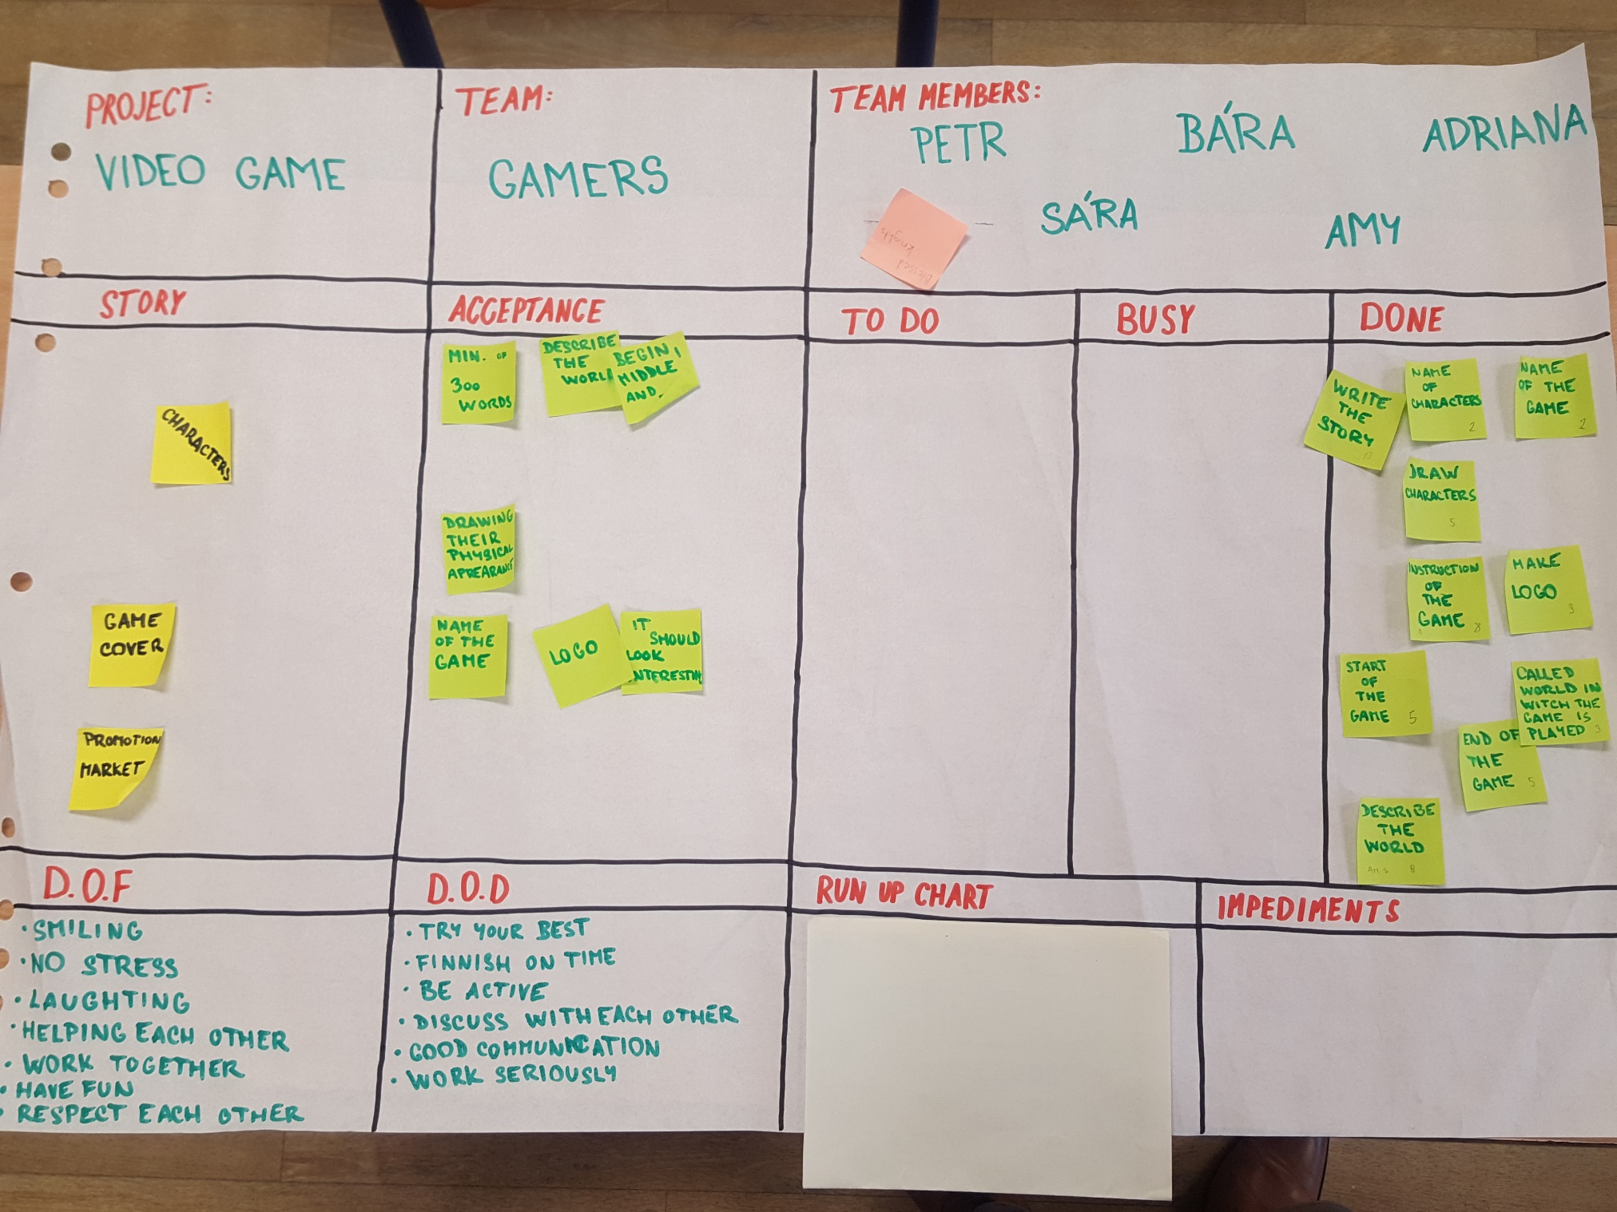

Slide 8
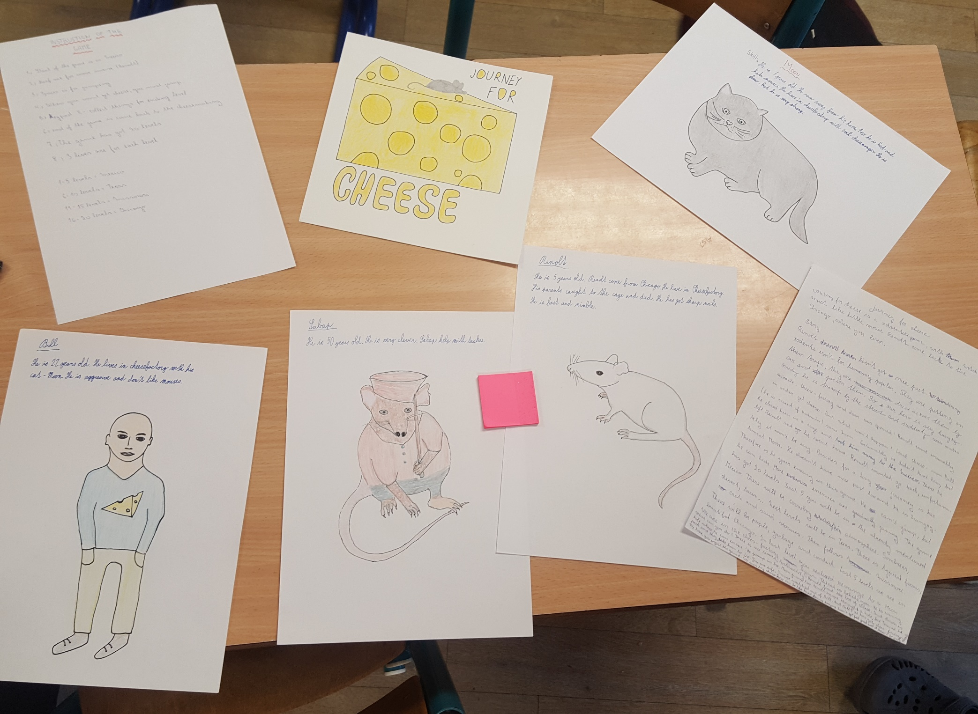

Slide 9
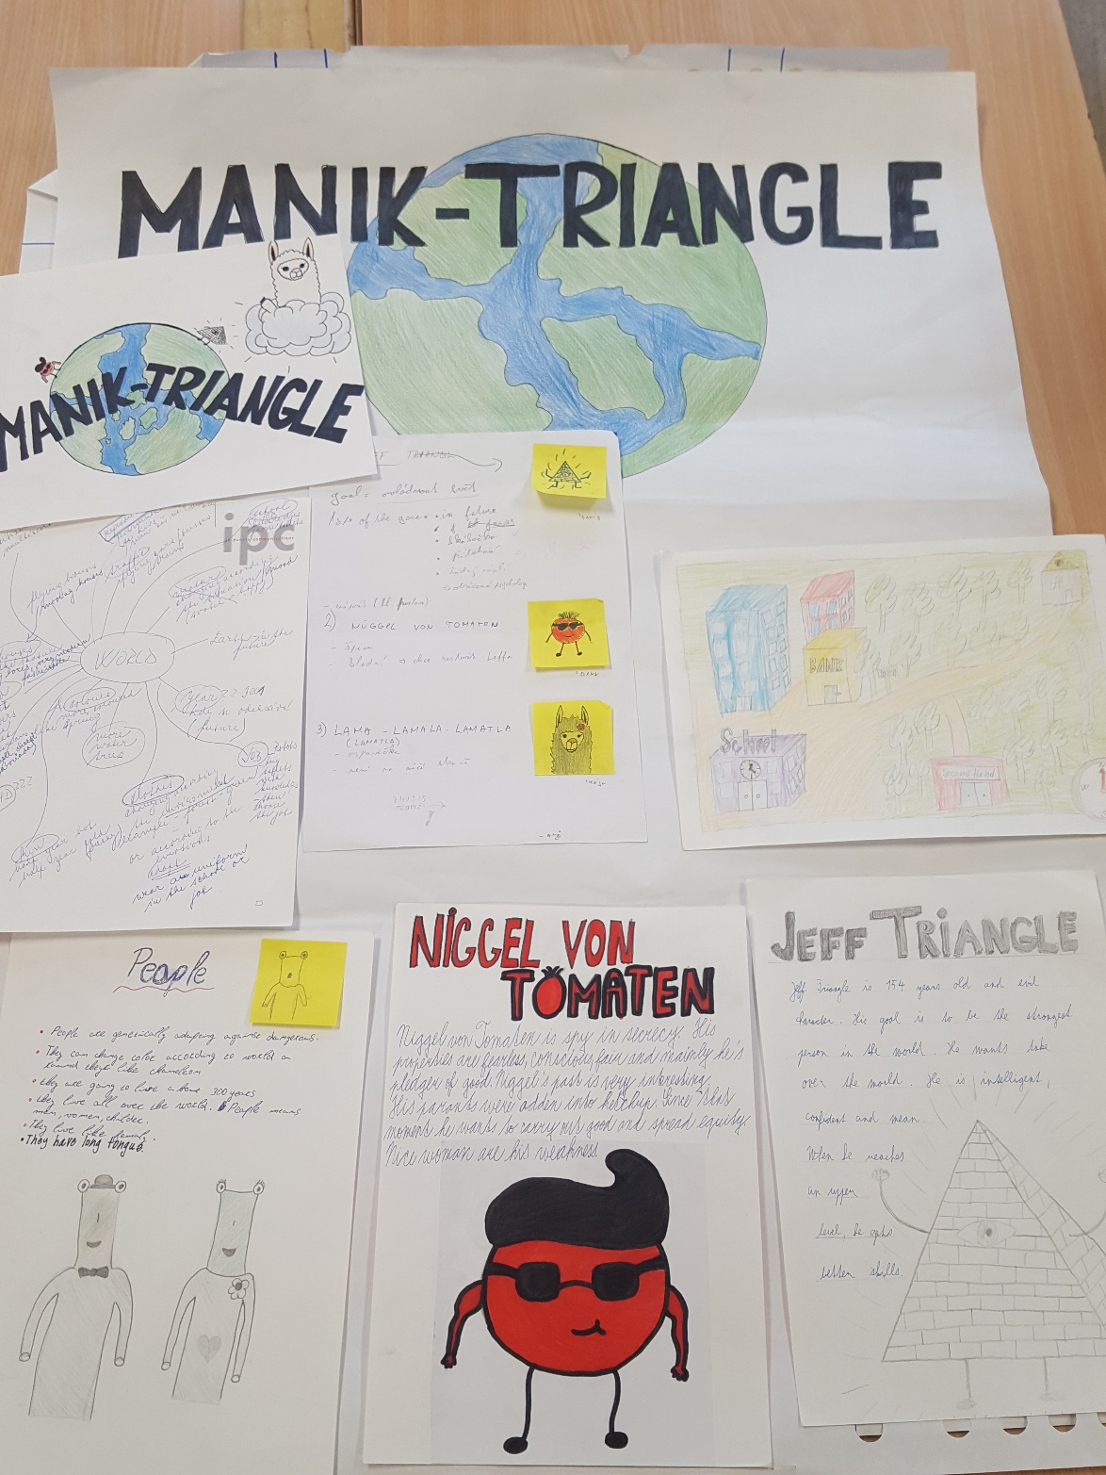

Slide 11
“I might even start enjoying going to school.”
Ondra

