Slide 1
SEPTEMBER 11-12, 2017
Forget about Agile for a second!
Nataliia KSENZHEK CSM, PROJECT MANAGER, EPAM SYSTEMS CZ

Slide 2
Our interpretation of Agile Manifesto
1. WORKING AS A TEAM
INDIVIDUALS AND INTERACTIONS | OVER | processes and tools
WORKING SOFTWARE | OVER | comprehensive documentation
CUSTOMER COLLABORATION | OVER | contract negotiation
RESPONDING TO CHANGE | OVER | following a plan
2.BUILDING THE RIGHT THING
3.BUILDING IT RIGHT
CRAFTSMENSHIP OVER CRAP Robert C. Martin
Kent Beck - Mike Beedle - Arie van Bennekum - Alistair Cockburn - Ward Cunningham - Martin Fowler - James Grenning - Jim Highsmith - Andrew Hunt - Ron Jeffries - Jon Kern - Brian Marick - Robert C. Martin - Steve Mellor - Ken Schwaber - Jeff Sutherland - Dave Thomas © 2001, the above authors this declaration may be freely copied in any form, but only in its entirety through this notice.

Slide 3
Challenges we faced
Tactical
Strategical
Cultural
Tactical
What to do?
How to do?
Principles?
Strategical
Organization structure change challenge
New positions
New priorities
Cultural
Company values
Company philosophy
People’s mindset
“It won’t work here!” problem

Slide 4
Practice 5 min
Practice 5 min
1
Organize groups of 4-5 people
Take a piece of paper and a pen
2
Discuss your challenges. Write them down
Group them as per the pie chart

Slide 5
To be successful we need
Mindset
Principles
Practices
Values

Slide 6
Agile Umbrella
TDD
XP
Pair Programming
CI/CD
Coding Standard
Planning Game
Lean
SCRUM
Refactoring
Time boxed
Increment
Kanban

Slide 7
Why it is challenging?
Lack of Company Culture
Lack of Team Culture
Lack of Agile mindset
CHALLENGE

Slide 8
Solving challenges
Tactical
Do the trainings
Help applying theory in practice
Do the workshops
Teach in practice
Show the examples and success stories
Strategical
Organization structure changes proposals
Team re-grouping
PO and SM roles
Cultural
Reach the benefits of the practices not the practices itself
Show to people the benefits of communication
Build trust
Shift from Mirco-manage to empowerment

Slide 9
Case 1. Release now

Slide 10
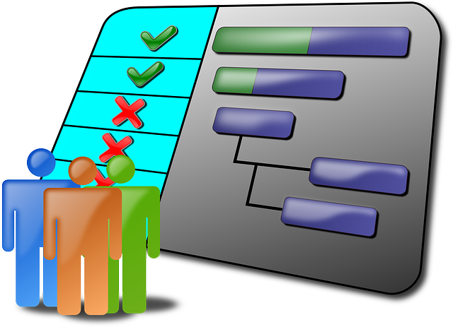
Case 2. Deadline

Slide 11
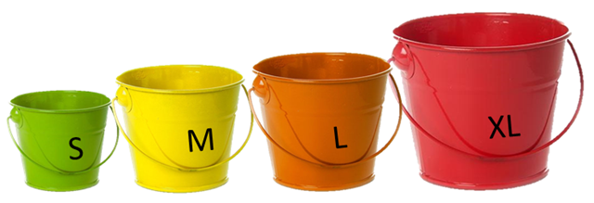
Case 3. I won’t do that

Slide 12
Summary
Listening
Communication
Recognition
Work as a team
Review
Adopt
Demonstrate
Do the Right things
Focus
Validate
Deliver
Do the things Right

Slide 13
Thank you
www.epam.com
Nataliia_Ksenzhek@epam.com

