Slide 1
Bugfighter 101
Fighting bugs or piling them?
Anton Březina
September 12, Agile Prague 2017

Slide 2
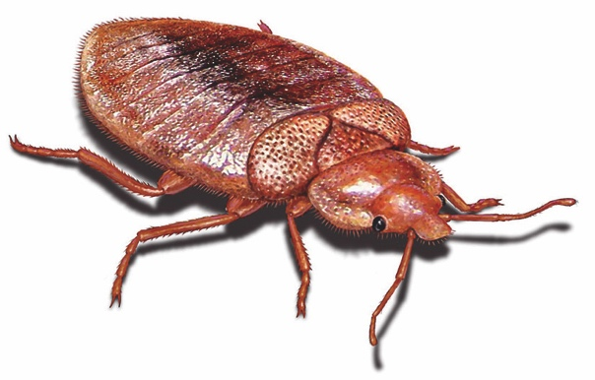
error, flaw, failure or fault in a computer program or system that causes it to produce an incorrect or unexpected result, or to behave in unintended ways [wiki]
Miscommunication of requirements
Design
Lack of version control
Buggy third-party tools
Human factors
Poor testing
Unrealistic time schedule
Last minute changes
…

Slide 3
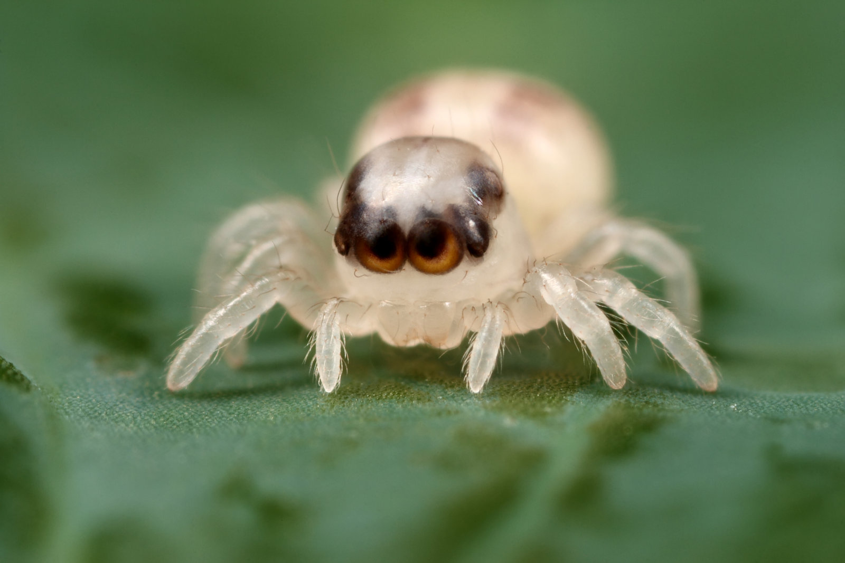

Slide 4
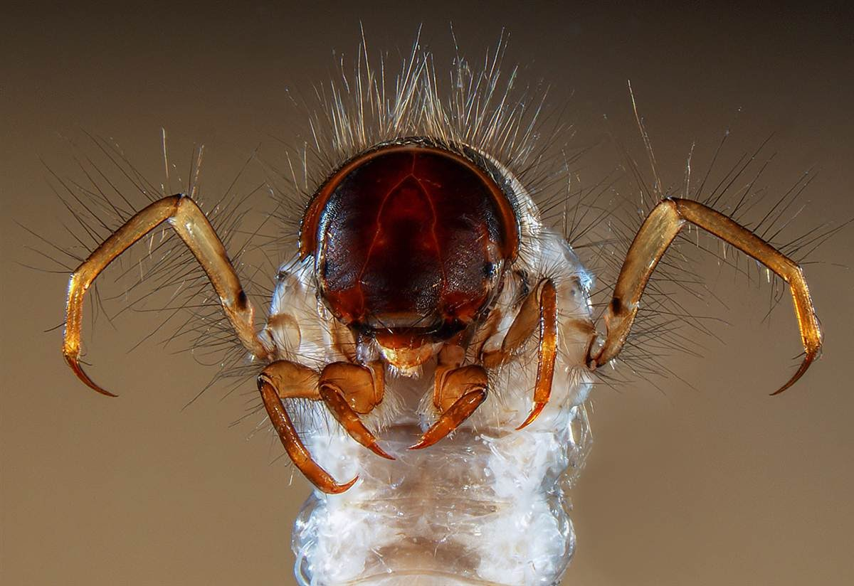

Slide 5
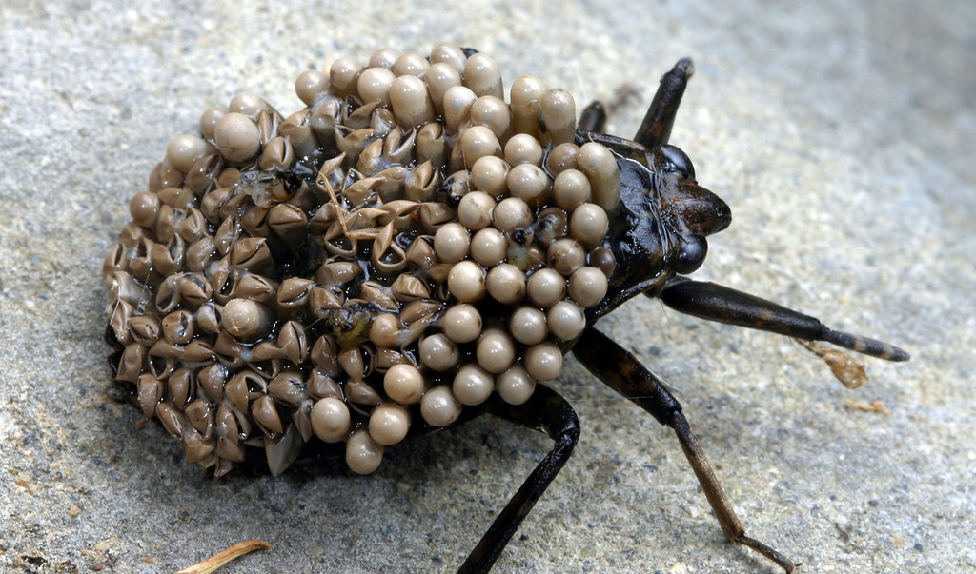

Slide 6
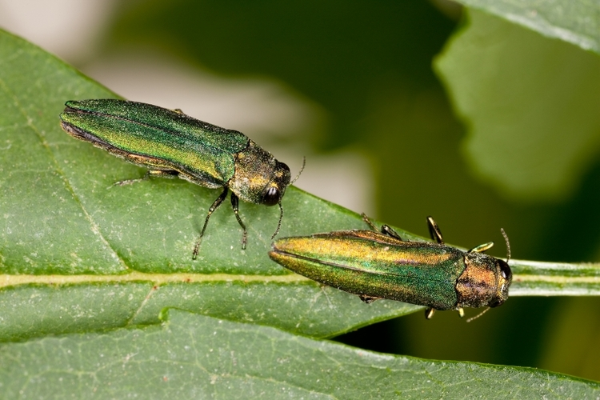

Slide 7


Slide 8


Slide 9
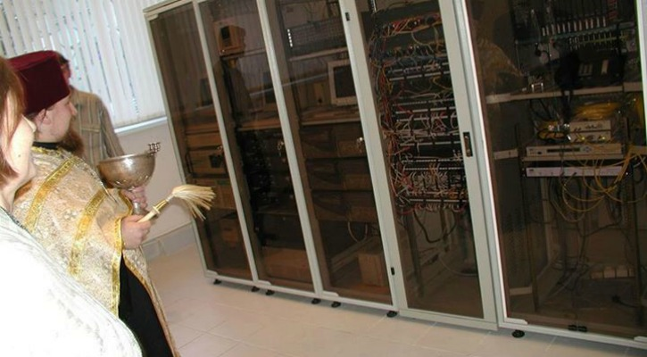

Slide 10
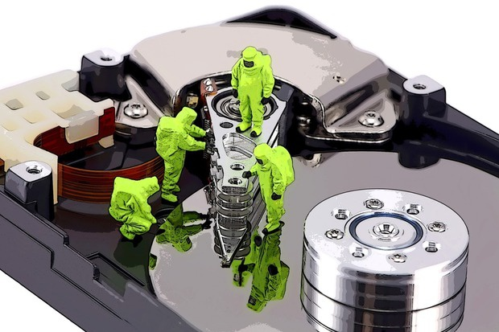
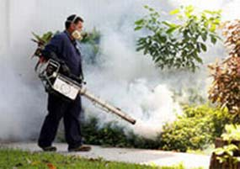
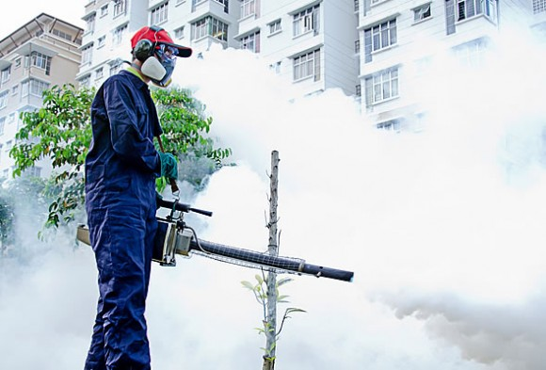

Slide 11
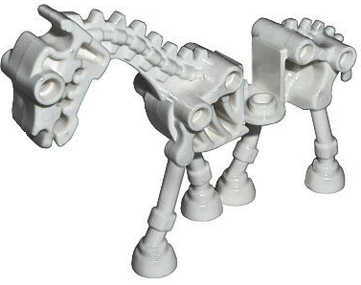
Admit it’s buggy and …
…won’t fix the bugs!
transparently and per informed decision based on
  age
  recent activity
  customers affected
  business impact
  complexity of the fix
  reproducibility
  bizarre environments
  time constraints
  …

Slide 12
Use common sense
consider application’s market value
  is it worth fixing old issues?
  is it worth fixing new issues?
  is it worth refactoring?
  be prepared to reopen won’t fixed bugs if it makes sense
play fair with your customers
  admit it is legacy software
  propose migration to new solutions
play fair with your employees and colleagues
  admit you have limited resources
  working on new features is more fun than fixing old issues
  60:20:20

Slide 13
Bugs will keep coming
Reported from:
  automated tests
  manual testing
  bug bashes
  support & customer reports
  integration
  …

Slide 14
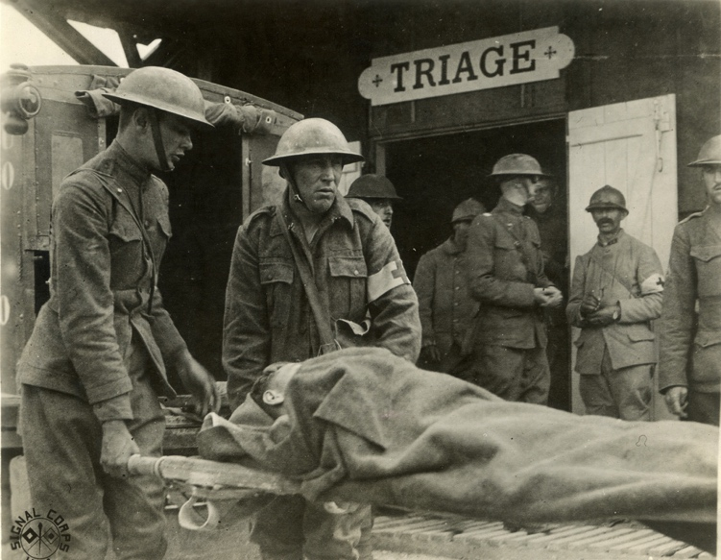
Bug triage – who?
developer
tester
product manager
scrum master
team leader
support engineer
customer representative

Slide 15
Bug triage – what?
well described?
reproducible?
new or duplicate?
correct project?
correct priority?
impact
ability to fix
complexity of the fix

Slide 16
Bug triage – what am I doing wrong?
bug triage ≠ status meeting
responsibility vs. authority
keep it short and focused
  too many attendees
  attendees not involved in the triaged project
too many P1s
bug volleyball

Slide 17
Summing it up
get your current bug backlog under control
get the flow of new bugs under control
get used to keeping it under control
promptly react to sudden bug infestations
keep an eye on old issues

Slide 18
Q&A

