Slide 1
@

Slide 2
Context & Customer
one of Austria’s largest insurance companies
Founded in 1798
About 50 employees at Merkur IT
About 800 in total
Notes:
800 people in total
Operations not yet included

Slide 3
Pre-Agile – How it all began
Start in 2012
Replacement of a legacy system
Framework chosen: Scrum
First try with agile methods
Single team
Major change in their work habits
Agility was not welcomed by everyone
First delivery after two weeks
First major release after 6 months
Complete replacement took two years
Successfully delivered!
Notes:
Legacy System has been in place for about 20 Years
Tried for 8 years without success
All Plan Driven approaches with loads of Requirement Documents
Give Scrum a Try
Scaling was not wanted at this time → Focus on one team
Team mates were NOT exclusively allocated for that project
Maintainance
Some people were very reluctant
BSP: one person sitting in a workshop and doing nothing
When I came to the company 2 years later still the conversation was somehow over when he was seeing Sticky Notes
Very old structures
Used to plan driven management.
In some cases for over 25 years
Company existed for 220 years
2 years
Challenges not only on the technical side
Changes in Leadership Positions

Slide 4
What Next?
All 5 teams?
Operations?
Scaling?
Service respectively product?
What about the rest of the organization?

Slide 5
Pre-LeSS - Preparations
Workshop: Head of IT & Head of Software Development
Risks
Chances
Stakeholders
Processes
Limitations
Goals
…
Notes:
Workshop(s)
With Head of IT and Head of Software Development
The two main responsible Line Managers
Interest to apply a (de-)scaling framework did already exist.
LeSS Considered very likely → Analysis → decision underpinned with some facts, and figures.
What did we learn:
LeSS very is the right framework
most compatible approach
Early Adoption Moments sketched
Prepared the management

Slide 6
Main Goals
More flexibility
More focus
A common picture aka whole product focus
A better way of prioritizing requirements aka one Product Backlog
Better communication within and between teams, and other departments in the larger organization to achieve the highest customer value
Quality (as a more abstract definition)
Also more responsibility of teams was mentioned, and more understanding of requirements in the teams, but they were not identified as the main goals.
Notes:
More flexibility -> later understood as an aspect of agility
More focus -> also understood as part of agility;
side-effects:
reducing multitasking
reducing too long cycle times
A common picture
including understanding the entire product release
focussing on delivering Increments every Sprint
engagement of everybody involved
A better way of prioritizing requirements -> resulted later in one Product Backlog
Better communication within and between teams, and other departments in the larger organization to achieve the highest customer value -> resulted in faster feedback cycles, more transparency, supported by LeSS events and principles as walking-aid
Quality (as a more abstract definition) - Quality was mentioned in several contexts, e.g. requirements definition, communication with stakeholders and users, code quality, documentation, planning;
Also more responsibility of teams was mentioned, and more understanding of requirements in the teams, but there were not identified as the main goals.

Slide 7
Decisions
Scaling
LeSS
“Only” software development – operations later
Selected inhouse-customers first
Some “old” processes need to remain
Notes:
800 people in total
Operations not yet included

Slide 8
Product / Service Definition
One of the main responsibilities of Merkur IT is to ensure a trouble-free infrastructure, individual software development for the larger organization and support various heterogeneous applications needed to perform the daily business.
Notes:
800 people in total
Operations not yet included

Slide 9
Pre-LeSS – Delays
Changes in some management functions had influence to the planned endeavor.
A rebranding campaign, from a typical insurance company, to a “Vorsicherung” (preventive medicine, and activities) was launched. This had potential impact to the product definition.
The market image was planned to be changed, to become more modern. More transparency, but it had to be decided what to make transparent.
Notes:
„Presurance“
Three principles
Narrow & deep → only dev department
Top Down & Bottom Up
Volunteering

Slide 10
Pre-LeSS Situation & Activities
Fake Product Owner
Hired an external Product Owner
Formal LeSS and Scrum Training
Additional Delay due to changes at relevant positions
Notes:
With Line Manager
PO
New to the organisation
The product
And the role
Learning curve required
Fake Product Ownership conitued for about 4 month
Let us overcome this period

Slide 11
Organisational Structure
Feature Team finding workshop
Collocation
Knowledge silos, and “independent” tasks for individuals slowing down team-building
Cross-team cooperation happened automatically
Better coordination across teams for better Increments
Notes:
Initial Team Formation Workshop
Some requirements from the management
„even“ number of teammates
Not to many external developers in one team
…
Sitting in one room
Whiteboards
New furniture
Knowledge sharing at hoc is not possible
Used to be Experts → it was clear who will be need for feature X
At least the long journey in removing those silos started

Slide 12
Organizational Structure
Head of IT
Head of Development
Group 1
Group 2
Head of Operations
Group 3

Slide 13
What/How – Product
Update of Product Definition
What is the product?
Only one?
Are there many?
From which perspective?
Customer Centric Product Definition
IT-innovation, software- and system-services for management and sales of Merkur insurance.
This shift was hard to grasp
Notes:
no clear definition of the Product
Workshop with the two line manager
Main Questions
What is the product?
Is there only one product?
Are there many products?
From which perspective do we need to define, what the product could be?
A turn from a system-oriented product definition towards a customer centric product definition.
Another approach for products was to look at the different insurance areas, e.g. life insurances, health insurances, medical insurances, property insurances, and others. From an end-customer perspective, each tariff would be potentially a product. However, this product perspective still wasn’t beneficial enough.
Distinction between an internal and external view on “product(s)”.
A paradigm shift for many in the organization, especially those who worked for years with a different view.
Identification Issues for the teams
More Marketing, visioning and its sharing by the Product Owner would be needed
no clear definition of the Product.

Slide 14
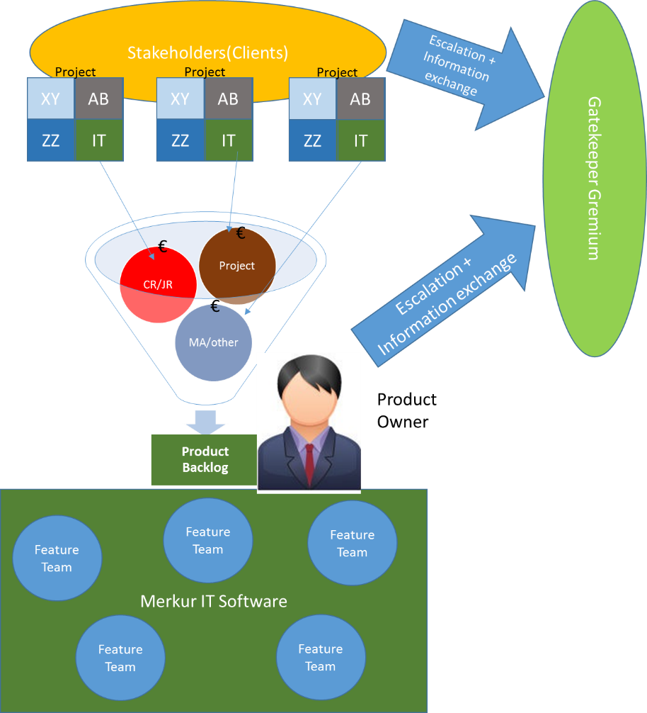
What/How – Product Ownership
Why not having Requirement Areas?
Gatekeeper Gremium
PO interaction with stakeholder
Elimination of direct control of end-users/stakeholders over developers.
The approval process changed to an approval checklist.
The role of Project Managers changed to the role of clients.
The overview over all planned, or wanted endeavors improved significantly.
Notes:
Requirement Areas:
Many discussions were made
Decision for only one Area
seasoned team-members – subject-matter expert contacts for special topics were introduced.
Still needed but are planed to get loose in the future
Gatekeeper at first glance counterproductive
Could be called in case of conflicts
Analysis showed that it was rather a chance
Platform for Information Sharing
Simplification certainly possible
Interaction with the Gremium changed a lot
Value based
Transparency
Direct Control over Developers for Projects
Eliminated with LeSS

Slide 15
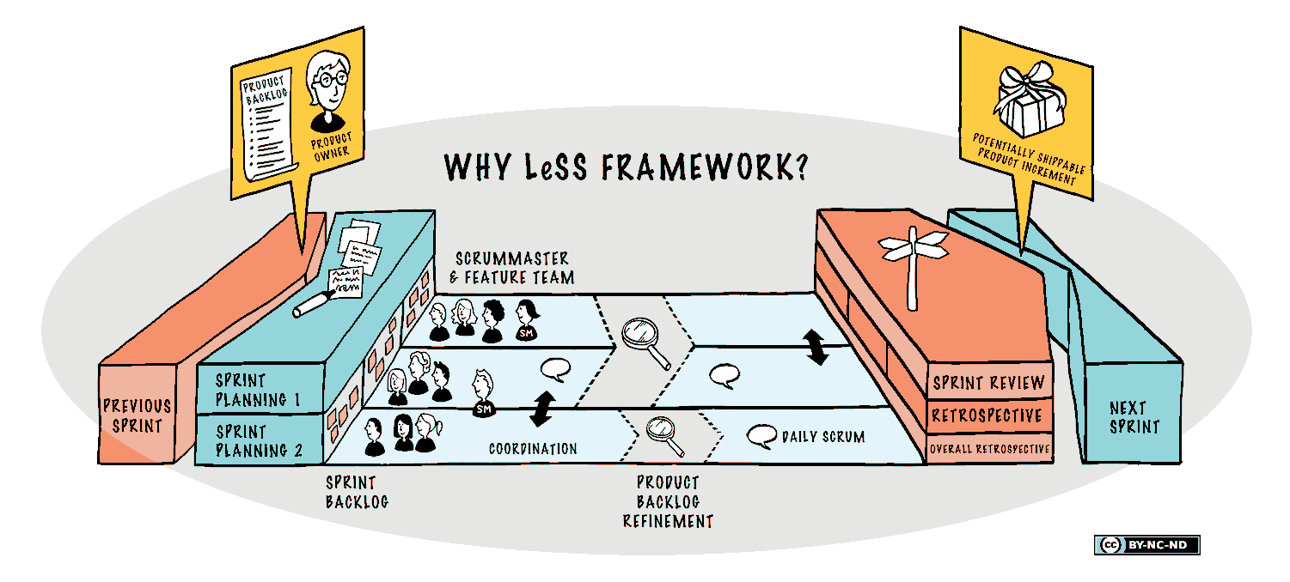
The Ceremonies
Pull in order
Facilitator
Focus Areas
Topic Focused
+ Alignment
Left to the team
Team rooms
Alignment
Overview session
Details in Team Rooms
Team Retros
Overall Retrospektives
Notes:
To pull in order of the backlog didn’t work out
Frustration
Not understanding
To people oriented
Facilitator changed often (Scrum Master / PO)
Newest Change: Back to topic focused SP1
BUT still the alignment.

Slide 16
Pitfalls – Lessons Learned
Not “brave” enough in terms of transparency
Scrum Master assignment to teams
Transition from component to feature teams very difficult in this environment
Acceptance of new Product Owner difficult
Room situation hindered ceremonies

Slide 17
Compromises we had to live with
Project Managers in the Merkur group (acting mainly as stakeholders and/or customers, some clarifying items and adding items to the Product Backlog)
Gatekeeper Gremium for more global implications and escalations
IT Operations not fully integrated in the Feature Teams, yet
Notes:
Rest of the organization
Could not let go
Stakeholders or POs
Shared Understanding over the whole organization

Slide 18
We celebrate 007 years JIPP.IT
JIPP.IT GmbH
Neugasse 111, 8200 Gleisdorf, Austria
Tel: +43 (0)3112 90 300 | office@jipp.it
Contact:
Christoph Schmied
Certified LeSS Practitioner
Tel.: +43 (0) 660 90 300 22
Email: christoph.schmied@jipp.it
Web: www.jipp.it
Twitter: @_SchmiedChris
Contact:
Dr. Wolfgang Richter
Certified LeSS Trainer
Tel.: +43 (0) 664 4423884
Email: wolfgang.richter@jipp.it
Web: www.jipp.it
Twitter: @woof0815

Slide 19
APPENDIX

Slide 20
Selection of LeSS concepts (experiments)
Product Owner (main instance for prioritization, and more)
Feature Teams (cross-functional, cross-component)
Meetings (Overall Retrospective slightly adjusted)
Line Management as supporting functions
Overall Product Backlog
Flat organization
Scrum Masters for max. 2 to 3 teams
Volunteering (to a certain degree)
Team rooms (as far as the facilities supported it)
Travelers

Slide 21
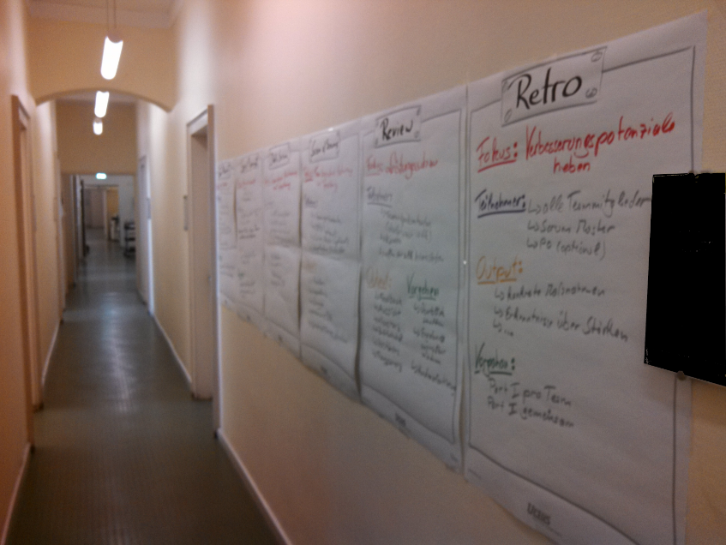
Visualization

Slide 22
Agile Transition – 10 Steps
Executive Commitment – The change must be wanted and supported
Know your starting point – Where are we, what do we need to the start
Goal Definition – Where do we want to go, what do we want to achieve
Identification of the main areas of concern – Who needs support the most
Definition of a team, which can accompany the change – Who is able to support the change and how

Slide 23
Agile Transition – 10 Steps
Risk Analysis – Potential consequences in case of problems and their mitigation
Definition of constraints – Time? Budget?
Definition of transition phases – Implications to existing projects and client relations
Definition, how to recognize progress – Measurements, Surveys
Acceptance Criteria – When will the change be good enough and sustainable

Slide 24
Transition Goal
Identify optimizing goals for your transition, e.g.:
We are able to react on changing requirements within a short time-frame, and are still able to deliver high value items based on our definition of business value within defined constraints.
Note: This is just an example! Your optimization goal(s) needs to be thouroughly identified in a workshop!

Slide 25
Getting Started
educate everyone
define ‘product’
define ‘done’
have appropriately structured teams
find the overall Product Owner
only the Product Owner provides work for the teams
keep project managers away from the teams AND
find Scrum Masters
re-organize line-management
establish internal and external coaching

Slide 26
Adoption Principles
deep and narrow over broad and shallow
top-down and bottom-up
use volunteering

Slide 27
Trainings
Scrum Fundamentals – Everyone
LeSS Fundamentals – Everyone
Scrum Mastery (processes, team formation, coaching, …) – Scrum Masters
Product Ownership – at least the overall Product Owner, better all people in teams, who support the Product Owner (Business Analysts, Area Product Owners, Requirements Engineers)
Organizational Design with LeSS (CLP, CLE) – selected people
Note: No new roles are attached, but specific skills are trained.

Slide 28
Coaching
Organizational coaching A coach works with multiple teams and the management to improve the organization and its structure
Team coaching (or LeSS coaching) A coach works with one or a few teams to improve their team-collaboration and LeSS practices. It is common for a coach to take on the Scrum Master role.
Technical practices coaching A coach works with (or on) a team on their actual codebase in order to improve the technical practices and adopt agile development techniques such as simple design, refactoring, unit testing, test-driven development and acceptance test-driven development.

Slide 29
Who coaches?
Internal AND external coaches
Different people with appropriate skill sets
Why more than one coach: A matter of time, capacity, and cognitive load.
Experience: Working with different people creates more insight, better perspectives, and more acceptance.

Slide 30
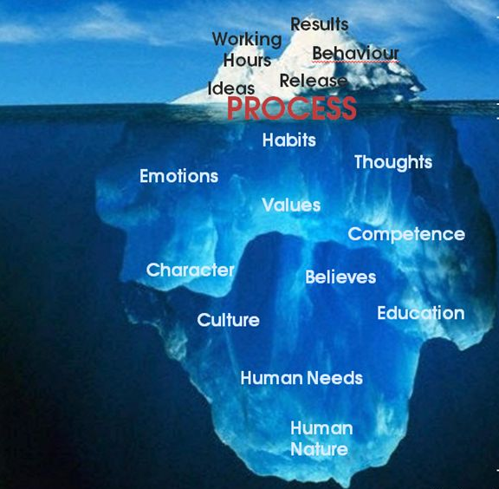
What does transition mean?
Agile Clients
Traditional
Agile
Traditional Clients
Client Communication
Principle: “Bridging the Gap” Dualism in:
Sales
Key Accounting
Requirements Management

